Slide 1
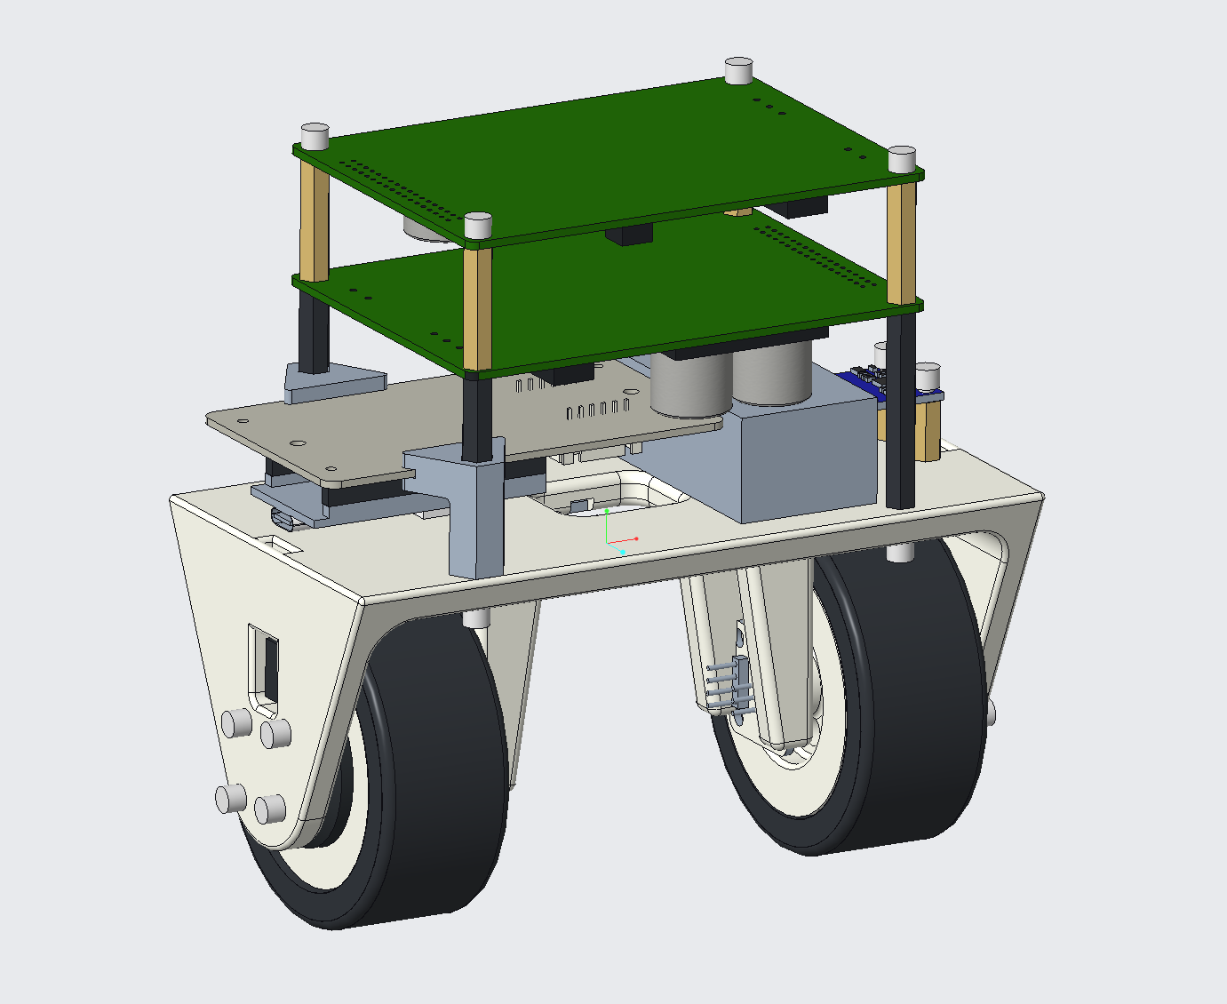

Slide 2
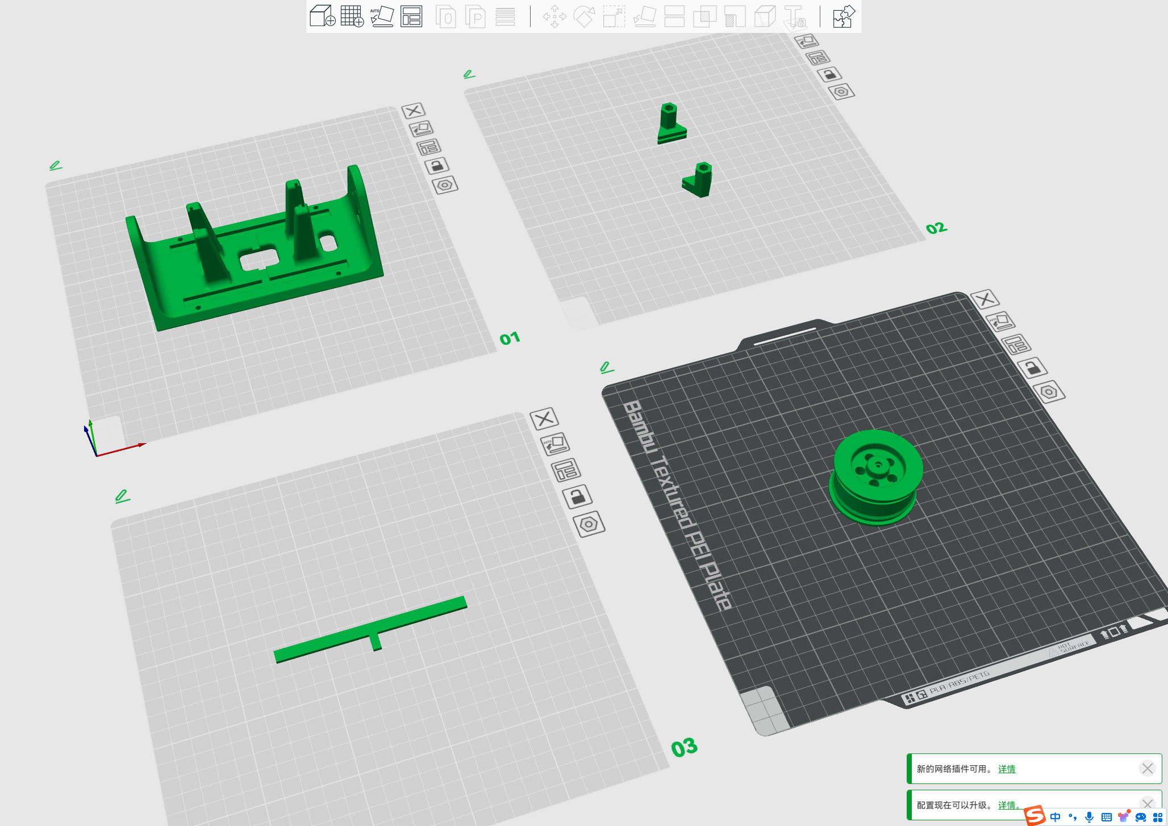

Slide 3
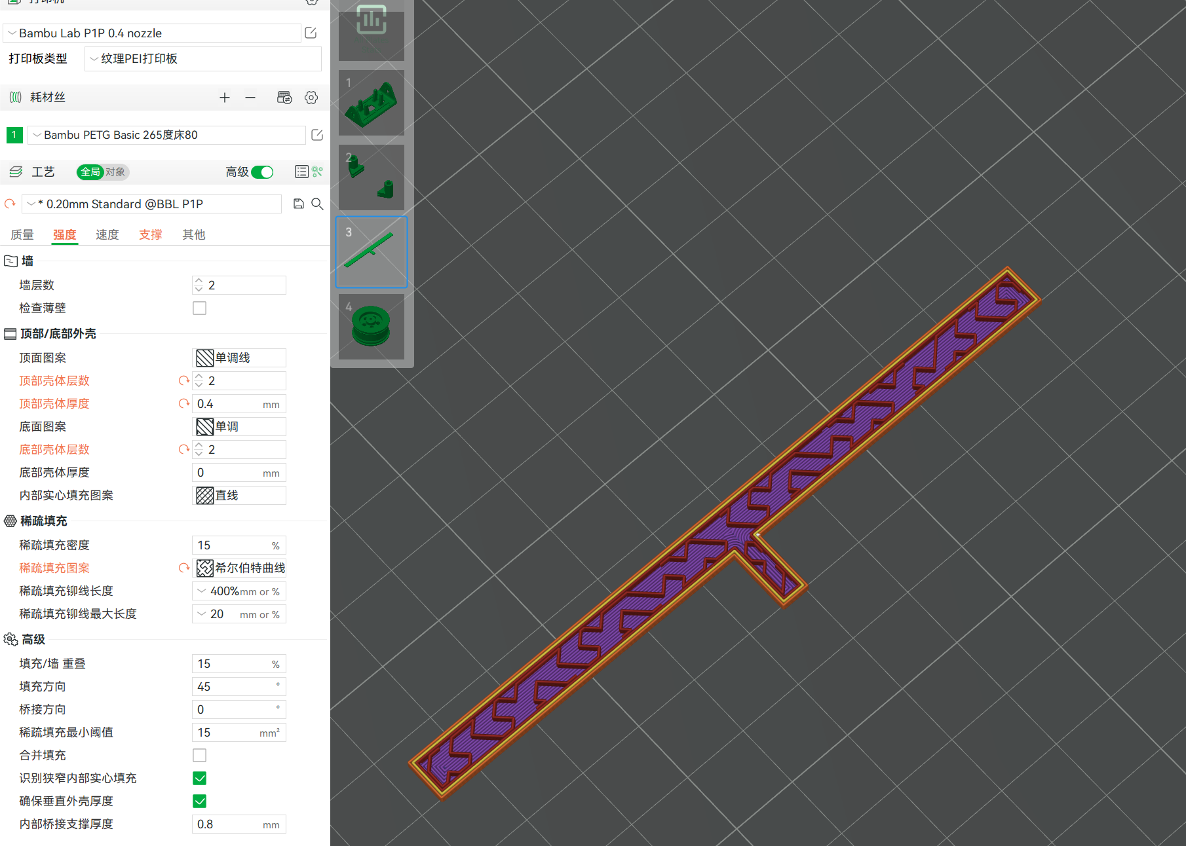

Slide 4
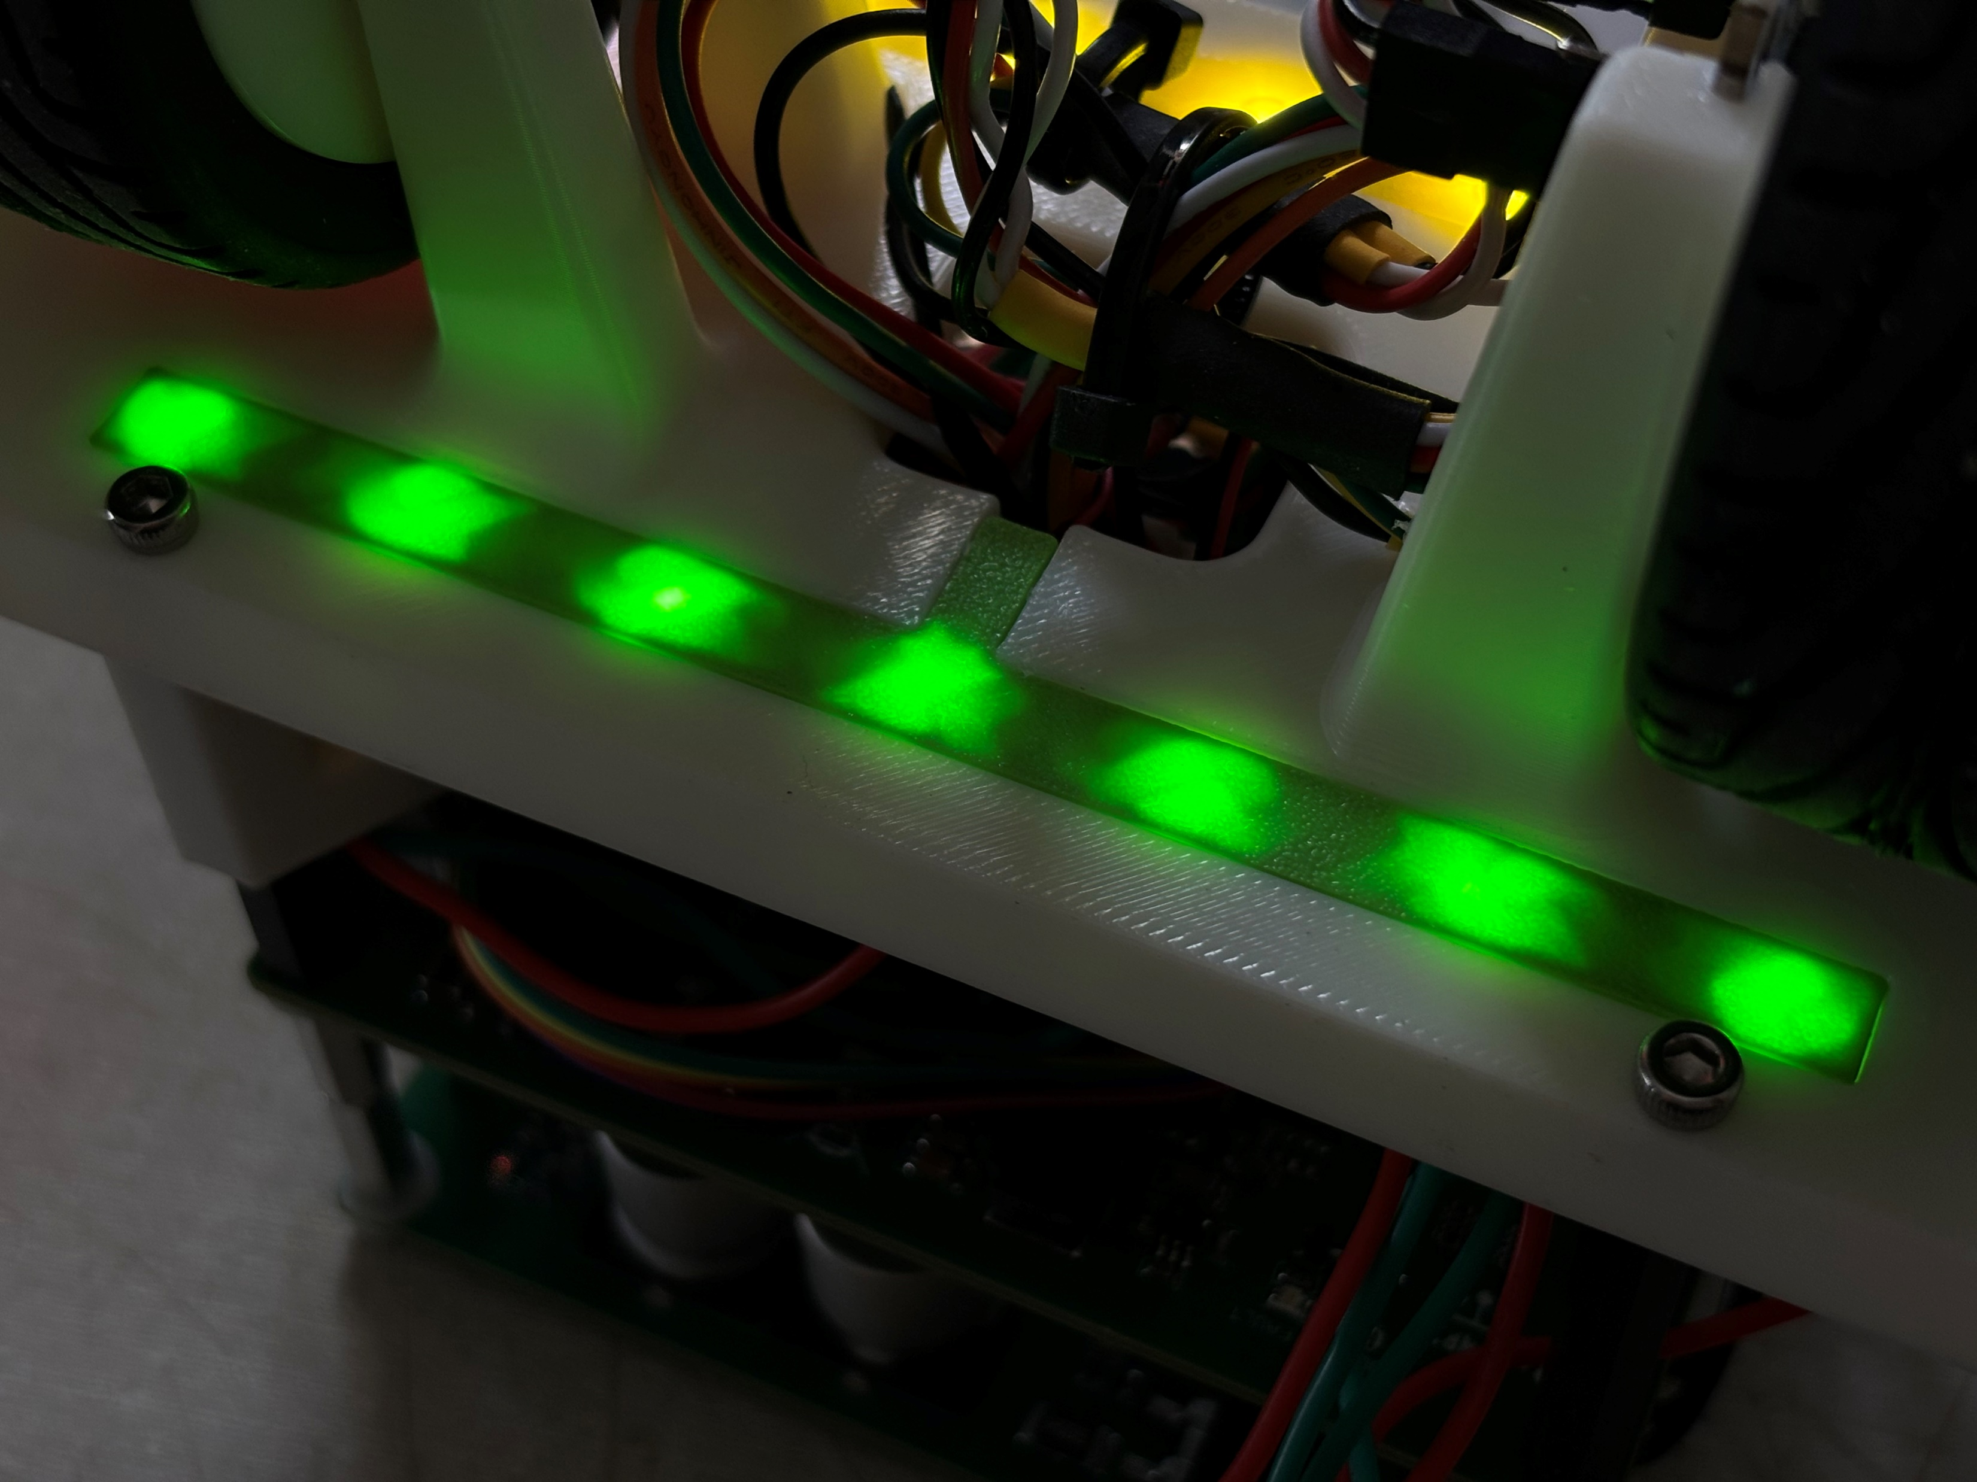

Slide 5
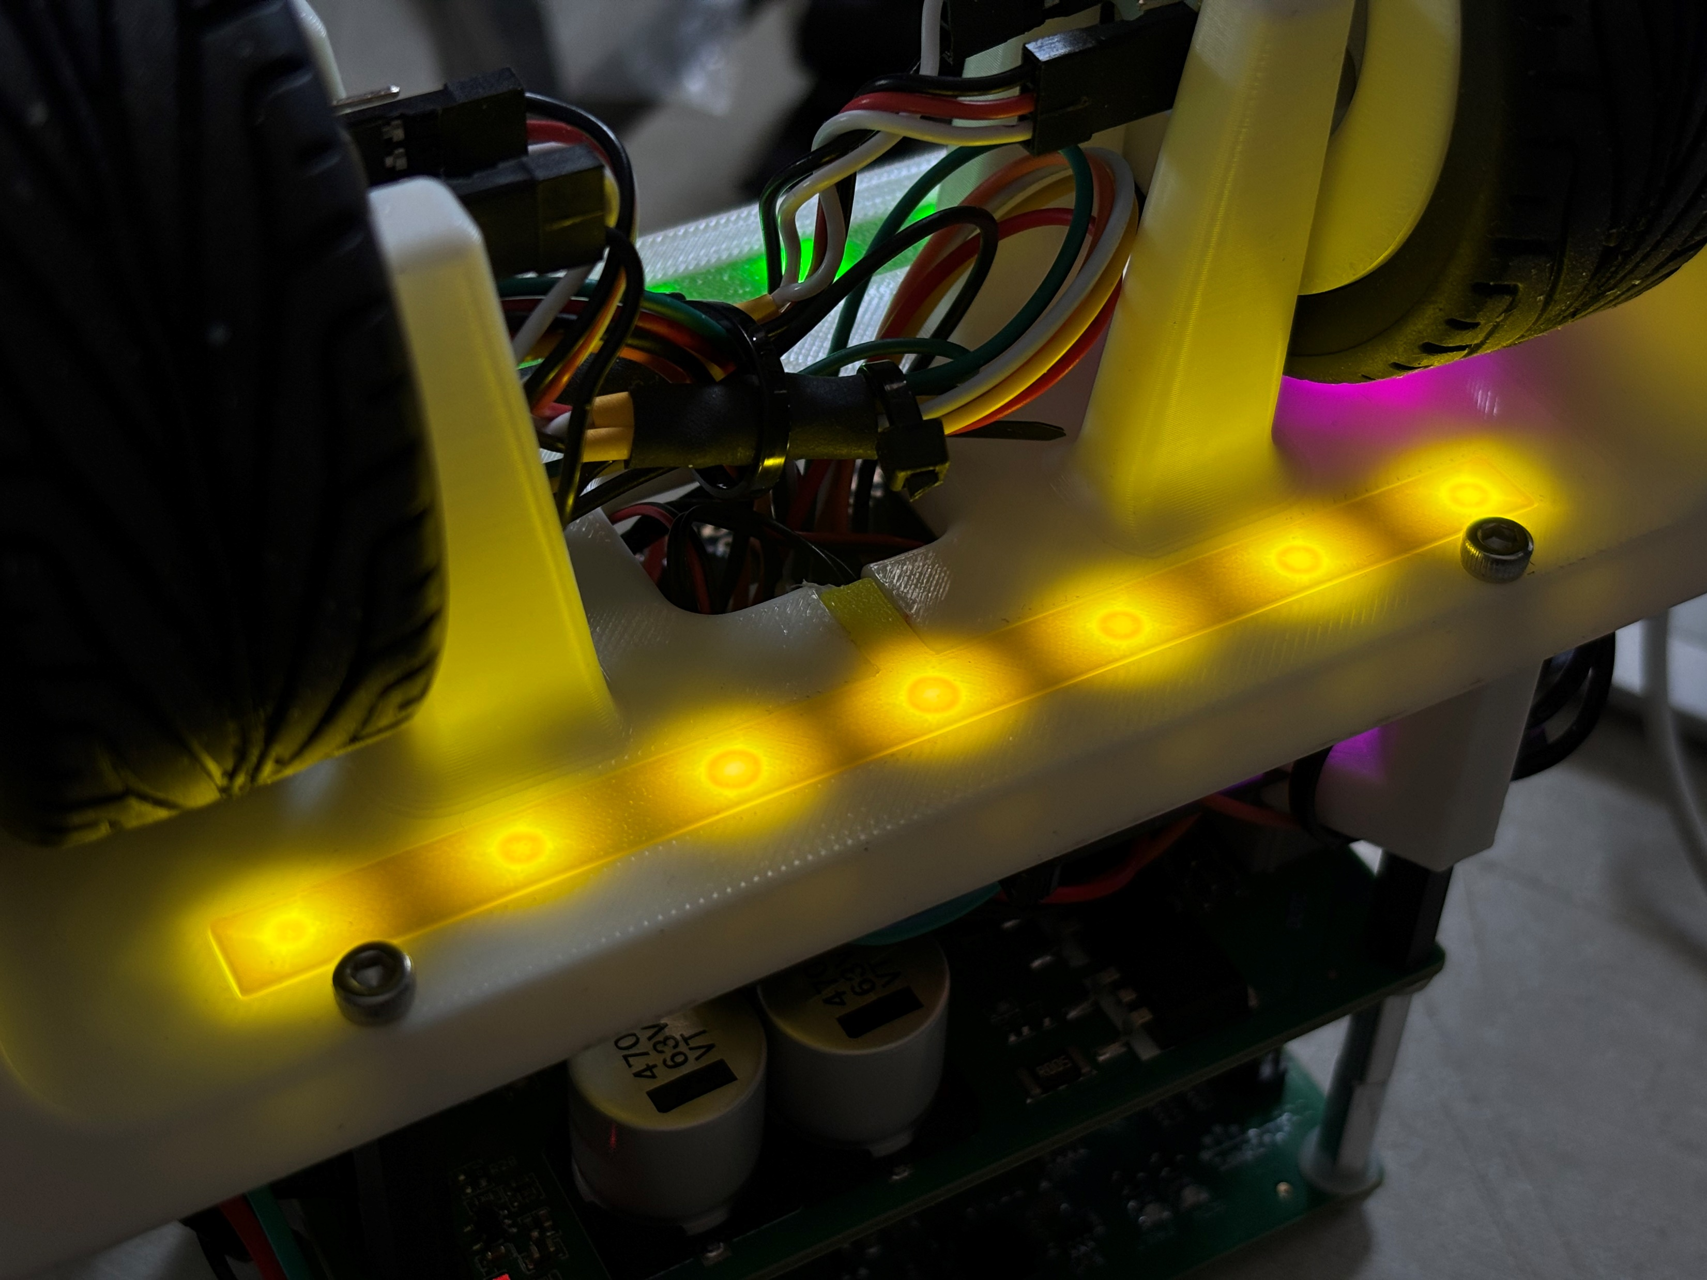

Slide 6
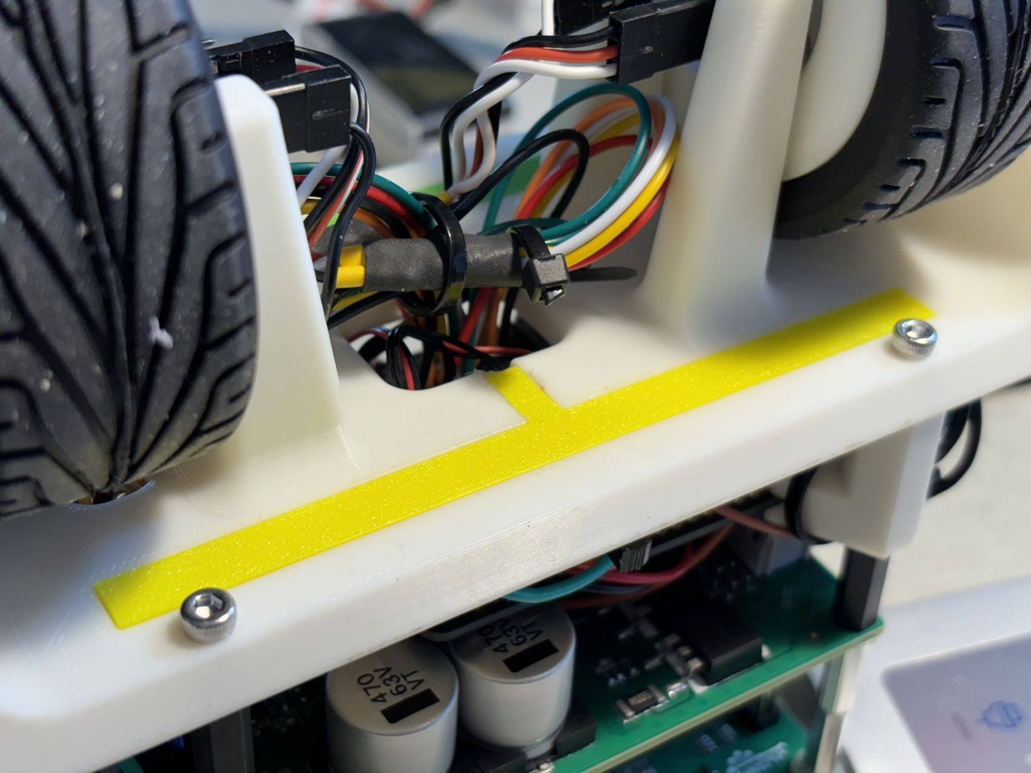

Slide 7
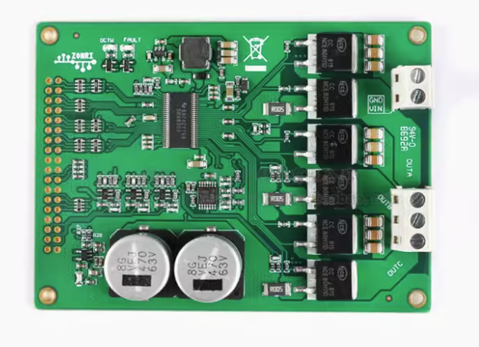
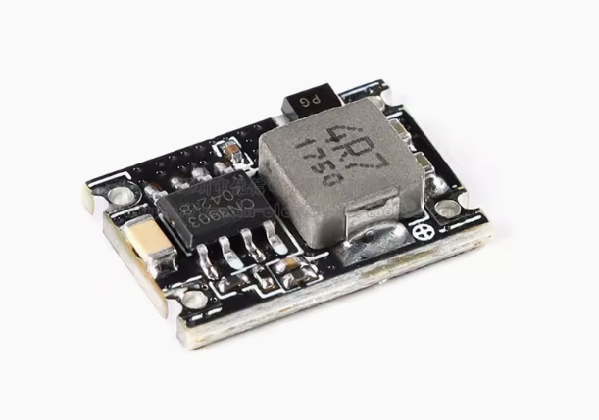
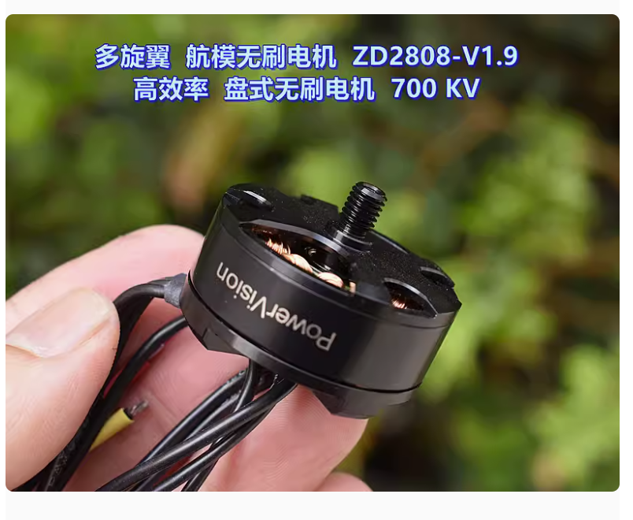

Slide 8
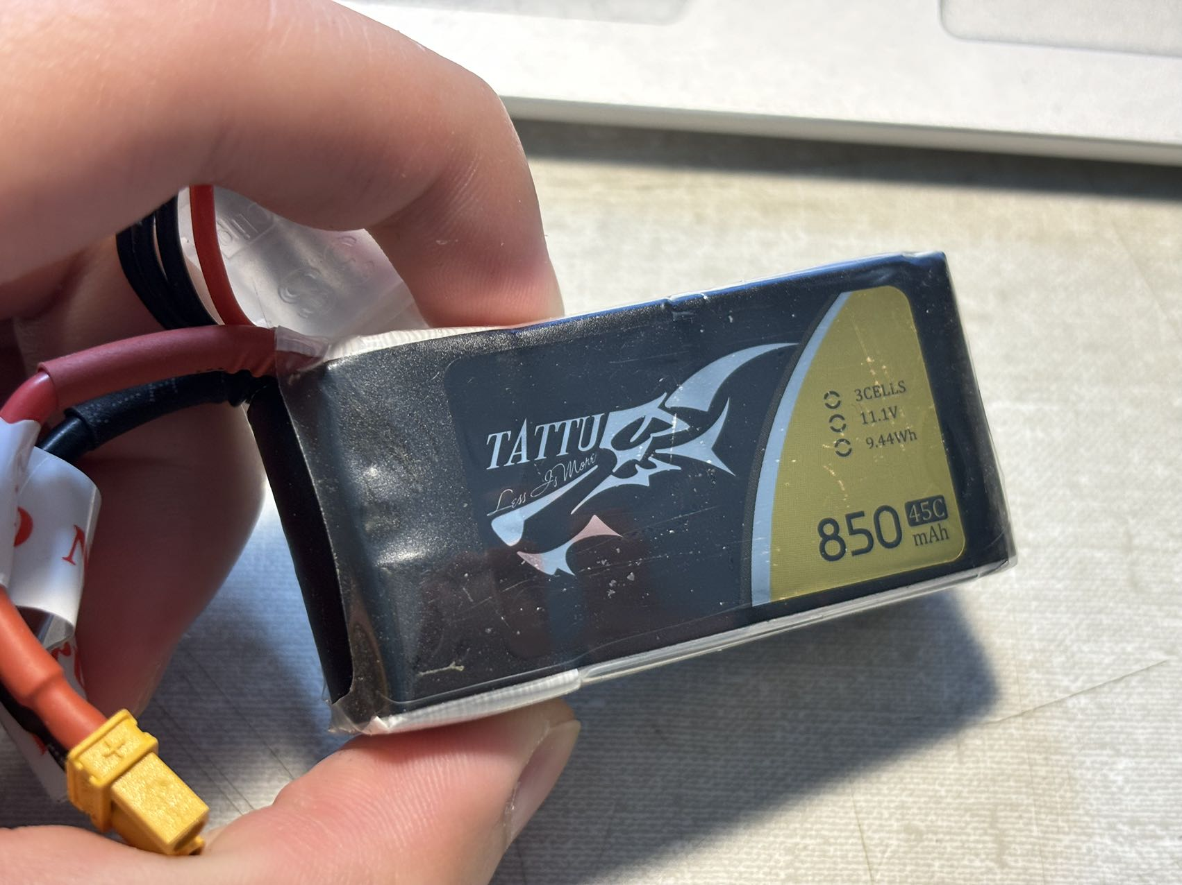

Slide 9
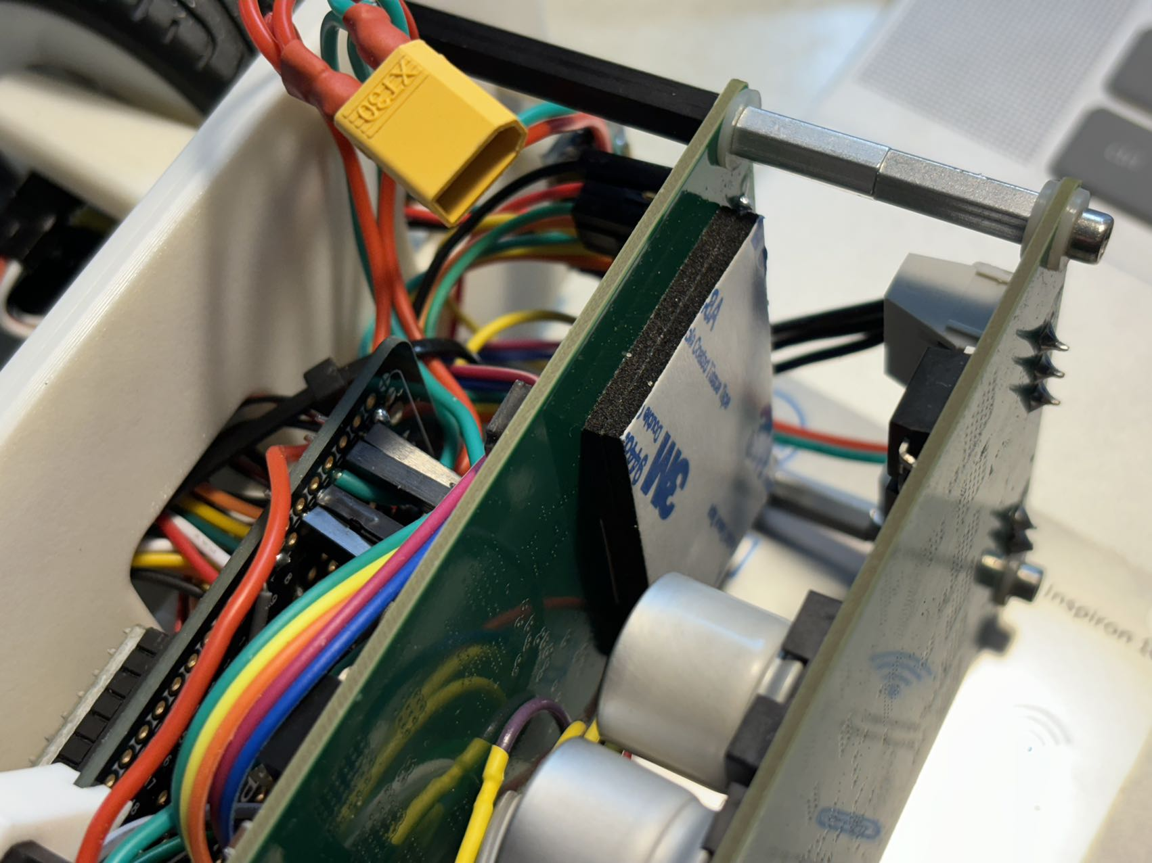

Slide 10
参考链接
Reference:
https://docs.simplefoc.com/drv8302_example
https://www.ti.com/lit/ds/symlink/drv8302.pdf?ts=1723239724335&ref_url=https%253A%252F%252Fwww.mouser.com%252F
http://dengfoc.com/#/dengfoc/%E7%81%AF%E5%93%A5%E6%89%8B%E6%8A%8A%E6%89%8B%E6%95%99%E4%BD%A0%E5%86%99FOC%E7%AE%97%E6%B3%95/4.2FOC%E5%BC%80%E7%8E%AF%E9%80%9F%E5%BA%A6%E4%BB%A3%E7%A0%81%E7%9A%84%E6%92%B0%E5%86%99

